Slide 1




SHRI GURU GOBIND SINGHJI INSTITUTE OF ENGINEERING AND TECHNOLOGY
AI Document Editor
An AI-Powered Smart Drafting System
PRESENTED BY
Vinayak Vishwanath Gaikwad
Reg. No. 2023BCS022
Vedant Milind Khete
Reg. No. 2023BCS024

Slide 2
Table of Contents
1.
Introduction & Problem Statement
5.
System Architecture
2.
Project Summary & Objectives
6.
Database Architecture
3.
Literature Survey
7.
Output & Results
4.
System Requirements & Setup
8.
Conclusions & Future Scope

Slide 3
Introduction & Problem Statement
The friction in modern authoring pipelines
Context-Switching Latency
Disjointed workflows disrupt continuous drafting.
Context Isolation
External AI lacks real-time document visibility.
Operational Friction
Manual text synchronization limits overall throughput.

Slide 4



Project Summary & Objectives
Unified Interface
Bidirectional Flow
Real-Time Context
Tightly coupled editor and conversational copilot.
Natural language prompts execute complex mutations.
Embedded AI ensures high-fidelity precise inferences.

Slide 5
Literature Survey
Analyzing current solutions
Existing Tools
Identified Gaps
Project Novelty
ChatGPT and Notion AI platforms.
Context isolation and operational friction.
Real-time bidirectional state synchronization.

Slide 6




Hardware & Software Requirements
Frontend
Backend
Next.js and Tailwind CSS frameworks.
Node.js with Express.js architecture.
Database
Services
MongoDB for flexible draft storage.
Google Gemini API and Docker integration.

Slide 7

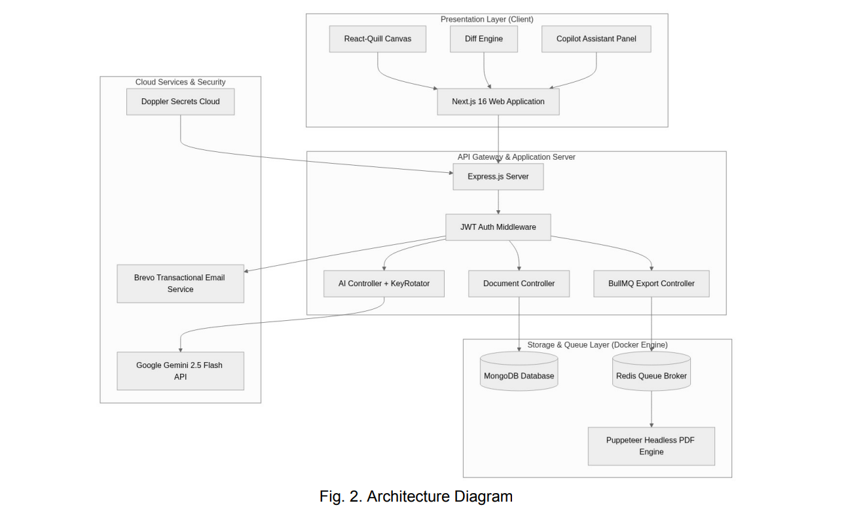
System Architecture
Core component integration
Presentation Layer
React-Quill Canvas and Diff Engine.
COMPONENT INTEGRATION DIAGRAM
API Gateway
Express server with JWT Authentication.
Storage Layer
MongoDB database and Redis Queue Broker.

Slide 8
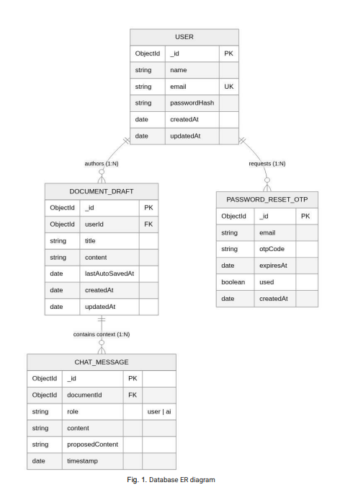
Database Architecture
Entity-relationship model and schema structure
User Entity
Secure credentials and profile management.
DATABASE ER DIAGRAM
people
description
Document Draft
Persistent state and active content tracking.
forum
Chat Message
Conversational history for context retention.

Slide 9
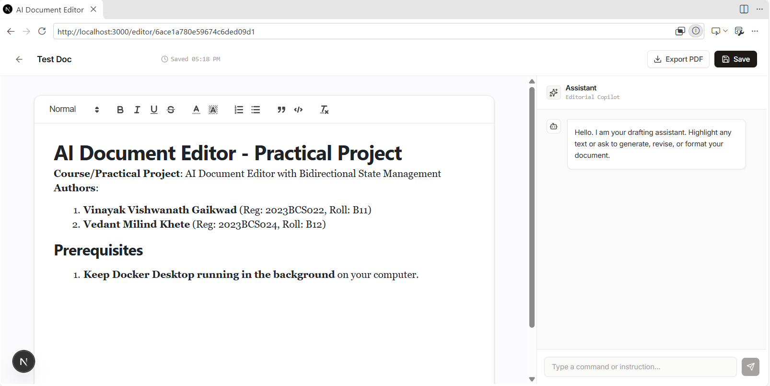
Output & Results
The unified interface in action
Rich-Text Canvas
Standard formatting and active selection tracking.
APPLICATION PREVIEW
Editorial Copilot
Persistent chat panel for natural language prompts.
Diff Preview
Redline additions and deletions for user review.

Slide 10



Conclusions & Future Scope
AI-Native Framework
Lifecycle Optimization
Future Expansion
Horizontal scaling and advanced customized PDF exports.
Transforms static editing into dynamic automated drafting.
Abstracts complex menu-driven formatting rules entirely.

Slide 11


References & Project Links
Google Gemini API Documentation
Next.js & React-Quill Integration Guides
Project Repository
https://github.com/VinayakGaikwad101/project-practical

